Slide 1
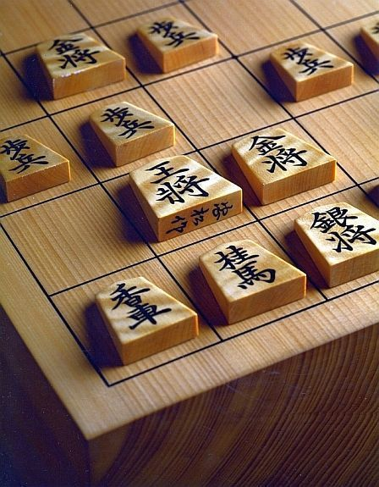
Shogi: The Japanese Chess Game
1
AUTHOR: Rolando Mignone

Slide 2
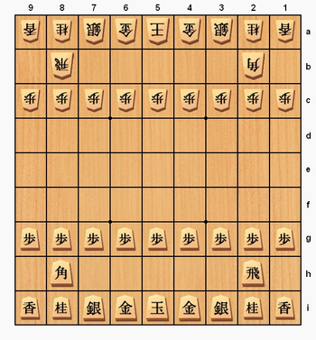
2
THE BOARD
BOARD V_2.0
Last Move: none
1. 2. 3. 4. 5. 6. 7. 8. 9.
+----+----+----+----+----+----+----+----+----+
|\ L/|\ N/|\ S/|\ G/|\ K/|\ G/|\ S/|\ N/|\ L/| 1.
+----+----+----+----+----+----+----+----+----+
| |\ R/| | | | | |\ B/| | 2.
+----+----+----+----+----+----+----+----+----+
|\ P/|\ P/|\ P/|\ P/|\ P/|\ P/|\ P/|\ P/|\ P/| 3.
+----+----+----+----+----+----+----+----+----+
| | | | | | | | | | 4.
+----+----+----+----+----+----+----+----+----+
| | | | | | | | | | 5.
+----+----+----+----+----+----+----+----+----+
| | | | | | | | | | 6.
+----+----+----+----+----+----+----+----+----+
|/ P\|/ P\|/ P\|/ P\|/ P\|/ P\|/ P\|/ P\|/ P\| 7.
+----+----+----+----+----+----+----+----+----+
| |/ B\| | | | | |/ R\| | 8.
+----+----+----+----+----+----+----+----+----+
|/ L\|/ N\|/ S\|/ G\|/ K\|/ G\|/ S\|/ N\|/ L\| 9.
+----+----+----+----+----+----+----+----+----+
SENTE'S PIECES: 9P, 2L, 2N, 2S, 2G, 1R, 1B
GOTE’S PIECES: none
int board[9][9] = {
{7,6,5,4,8,4,5,6,7},
{0,2,0,0,0,0,0,3,0},
{1,1,1,1,1,1,1,1,1},
{0,0,0,0,0,0,0,0,0},
{0,0,0,0,0,0,0,0,0},
{0,0,0,0,0,0,0,0,0},
{1,1,1,1,1,1,1,1,1},
{0,3,0,0,0,0,0,2,0},
{7,6,5,4,8,4,5,6,7},
};
int color[9][9] = {
{2,2,2,2,2,2,2,2,2},
{0,2,0,0,0,0,0,2,0},
{2,2,2,2,2,2,2,2,2},
{0,0,0,0,0,0,0,0,0},
{0,0,0,0,0,0,0,0,0},
{0,0,0,0,0,0,0,0,0},
{1,1,1,1,1,1,1,1,1},
{0,1,0,0,0,0,0,1,0},
{1,1,1,1,1,1,1,1,1},
};

Slide 3
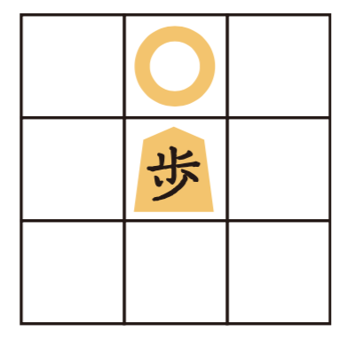
3
THE PAWN
BOARD V_2.0
/ P\ and \ P/
if((board[move[2]][move[3]] == n ||
color[move[2]][move[3]] == gote) &&
ch == sente && (move[0]-move[2]) == 1 &&
move[1] == move[3])

Slide 4
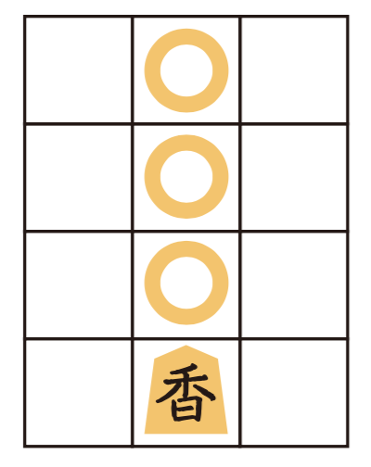
4
THE LANCE
BOARD V_1.0
/ L\ and \ L/
if((board[moveCk[2]][moveCk[3]] == n ||
color[moveCk[2]][moveCk[3]] == gote) &&
ck_h == sente && (moveCk[0]-moveCk[2]) >= 1 &&
moveCk[1] == moveCk[3])

Slide 5
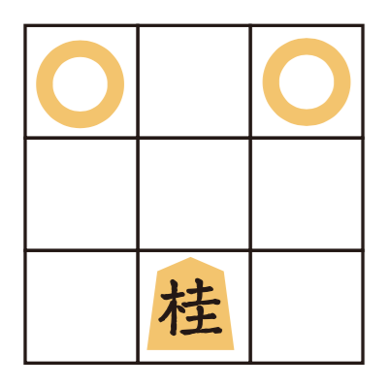
5
THE KNIGHT
BOARD V_1.0
/ N\ and \ N/
if((board[move[2]][move[3]] == n ||
color[move[2]][move[3]] == gote) &&
ch == sente && move[2] == move[0]-2 &&
(move[3] == move[1]-1 || move[3] == move[1]+1))

Slide 6
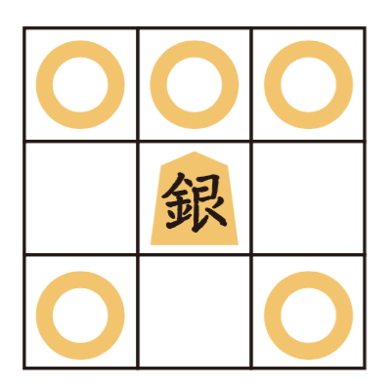
6
THE SILVER
BOARD V_1.0
/ K\ and \ K/
if((board[moveCk[2]][moveCk[3]] == n ||
color[moveCk[2]][moveCk[3]] == gote) && ck_h ==
sente &&
((moveCk[0]+1 == moveCk[2] || moveCk[0]-1 == moveCk[2]) && (moveCk[1]+1 == moveCk[3] || moveCk[1]-1 == moveCk[3] || moveCk[1] == moveCk[3]) && !(moveCk[2] == moveCk[0]+1 && moveCk[1] == moveCk[3])))

Slide 7
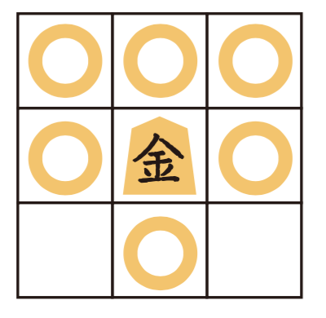
7
THE GOLD
BOARD V_1.0
/ K\ and \ K/
if((board[moveCk[2]][moveCk[3]] == n || color[moveCk[2]][moveCk[3]] == gote) &&
ck_h == sente && ((moveCk[0]+1 == moveCk[2] || moveCk[0]-1 == moveCk[2] || moveCk[0] == moveCk[2]) && (moveCk[1]+1 == moveCk[3] || moveCk[1]-1 == moveCk[3] || moveCk[1] == moveCk[3]) && !((moveCk[2] == moveCk[0]+1 && moveCk[3] == moveCk[1]+1) || (moveCk[2] == moveCk[0]+1 && moveCk[3] == moveCk[1]-1)))

Slide 8
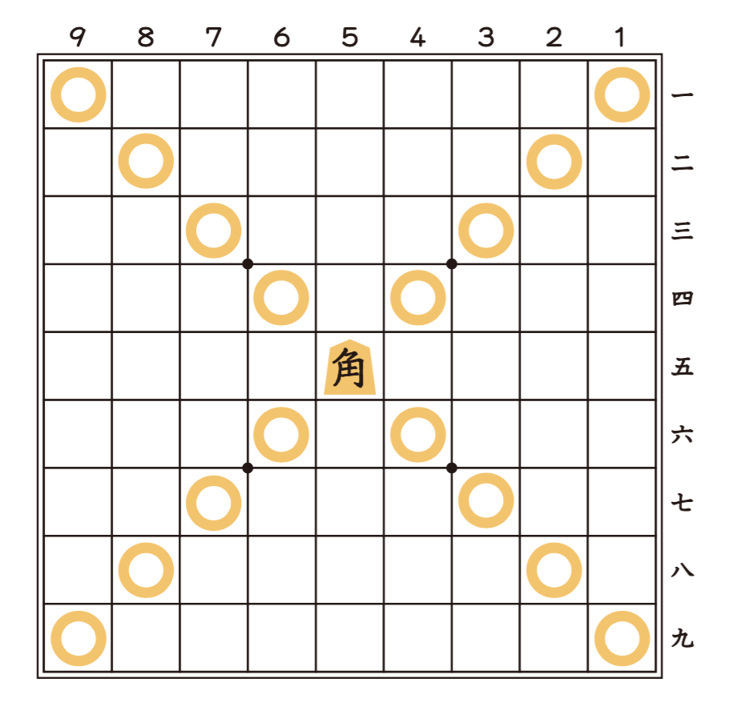
8
THE BISHOP
BOARD V_1.0
/ B\ and \ B/
if((board[move[2]][move[3]] == n |
color[move[2]][move[3]] == gote) &&
ch == sente &&
(move[0] - move[2] == move[3] - move[1] ||
move[0] - move[2] == move[1] - move[3] ||
move[2] - move[0] == move[1] - move[3] ||
move[2] - move[0] == move[3] - move[1]))

Slide 9
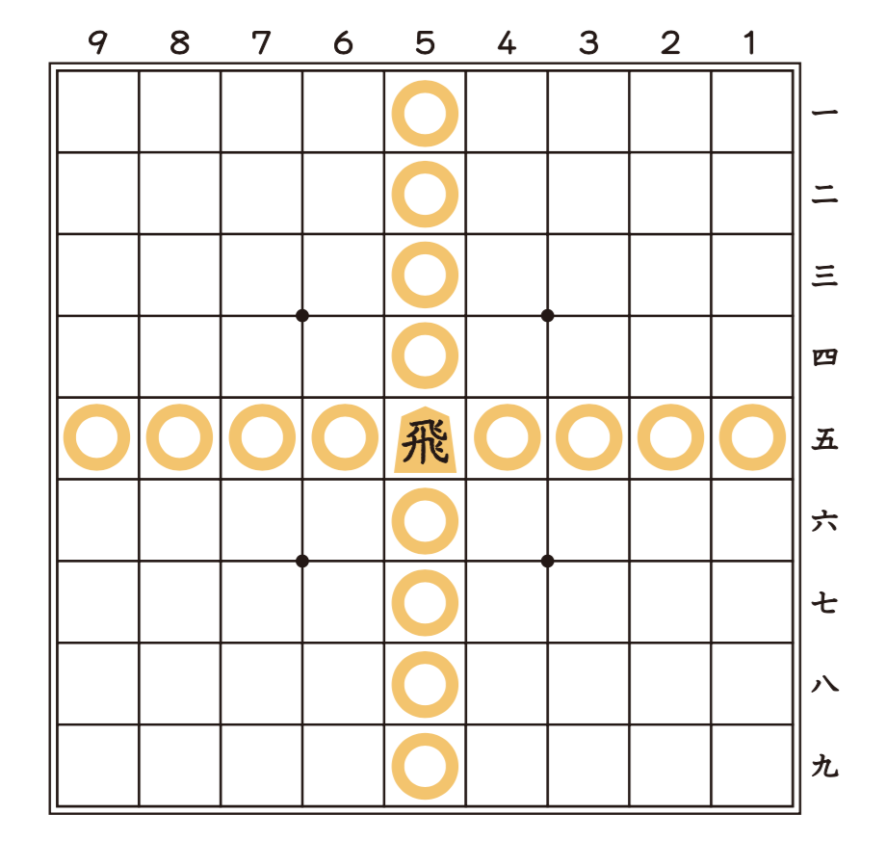
9
THE ROOK
BOARD V_1.0
/ R\ and \ R/
if((board[move[2]][move[3]] == n ||
color[move[2]][move[3]] == gote) && ch == sente
&& (move[1] == move[3] || move[0] == move[2]))

Slide 10
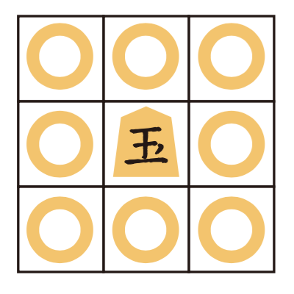
10
THE KING
BOARD V_1.0
/ K\ and \ K/
if((board[moveCk[2]][moveCk[3]] == n ||
color[moveCk[2]][moveCk[3]] == gote) &&
ck_h == sente &&
((moveCk[0]+1 == moveCk[2] ||
moveCk[0]-1 == moveCk[2] || moveCk[0] ==
moveCk[2]) && (moveCk[1]+1 == moveCk[3] ||
moveCk[1]-1 == moveCk[3] || moveCk[1] ==
moveCk[3])))

Slide 11
11
RULES
Shogi is a game played by two players. The first one who capture the opponent’s King or Jewel will win the game.
さす
sasu
[move]
うつ
utsu
[drop]
とる
toru
[capture]
なる
naru
[promote]
Two players move pieces by turns. Making a move is called “Sasu” in Japanese.
A piece that you have captured and held outside the board is named “Mochigoma” or a hand piece. Putting this piece on the board is called “Utsu.”
You can not drop two pawns on the same colum.
You can capture the opponent’s piece in your possible path. To capture a piece is referred to as “Toru.”
When your piece enters the opponent’s camp, you may turn over the piece to be transformed. This turning over is called “promotion,” and promoted piece is called “Narigoma”.

Slide 12
12
さす〜 Sasu
KING - / K\
LANCE - / L\
ROOK - / R\
SILVER - / S\
PAWN - / P\
BISHOP - / B\
KNIGHT - / N\
GOLD - / G\

Slide 13
13
なる〜 Naru
☖ 歩 〜 / P\
☖ 桂 〜 / N\
☖ 香 〜 / L\
☖ 銀 〜 / S\
☖ 金 〜 / G\

Slide 14
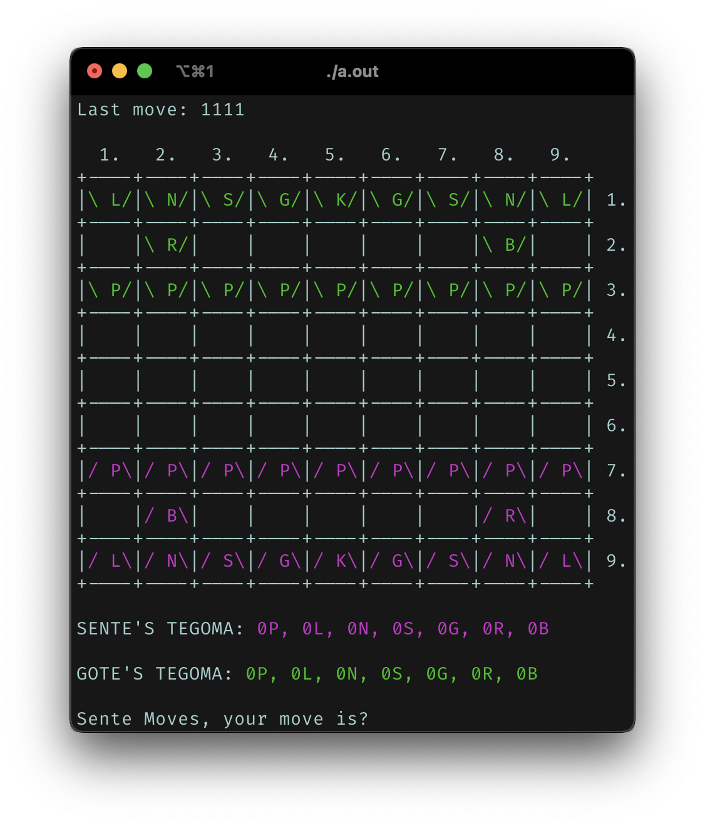
14
HOW TO PLAY
Compile & run:
☗ Linux: $gcc main.c –o a.out // Compile
☗ Mac: $clang main.c // Compile
☗ $./a.out // Run
Make moves:
☗[raw1][col1][raw2][col2] // (ex. “7363”, move the
pawn in the position “73” to the position “63”)
Drop pieces:
☗”0000” // Opens the menu
☗[piece] // Code of the piece to drop (ex. “1”, to
drop a pawn)
☗[raw][col] // Coordinates of the piece that u want
to drop
Win the game:
☗ Check mate the enemy king and take it down, the
one who do this will be the winner of the game.

Slide 15
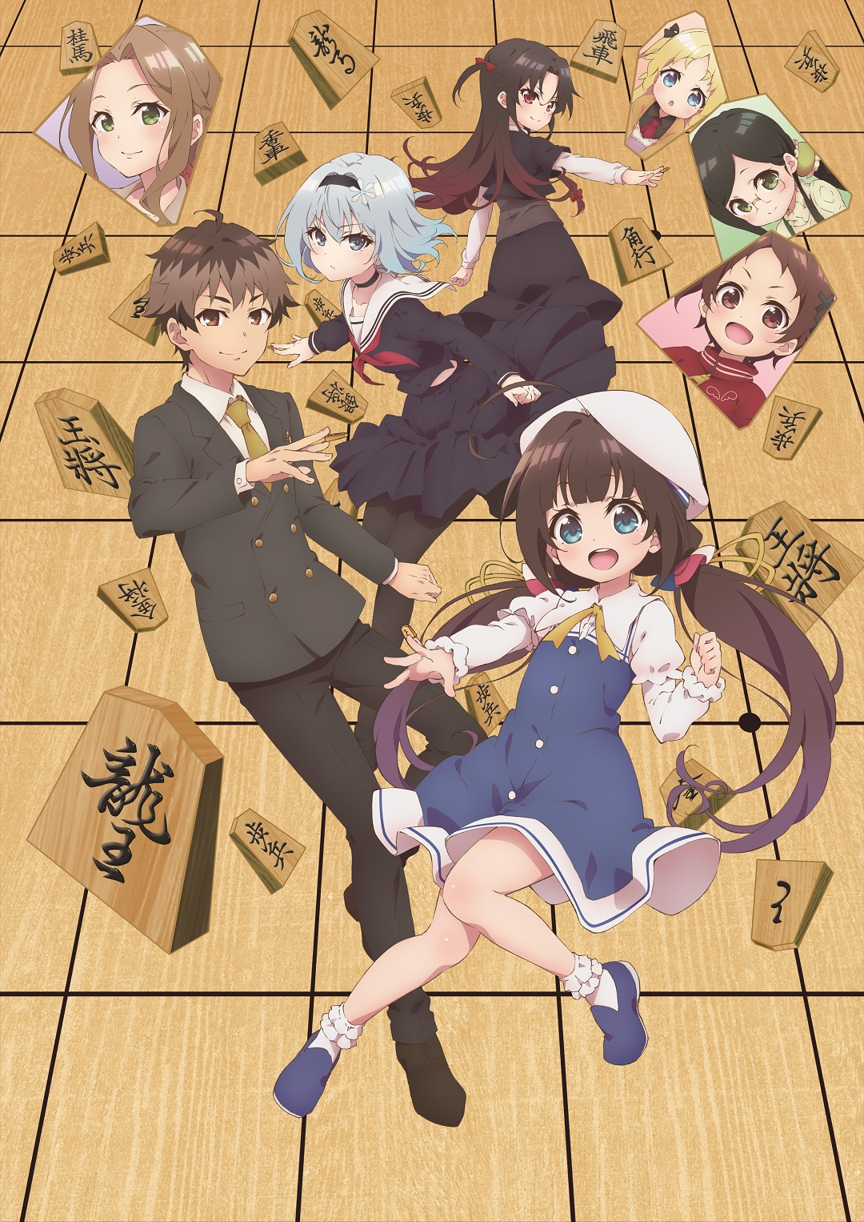
15
PROVERBS
Shogi has spawned a rich literature of proverbs:
Exchanging your Rook Pawn gives a four-fold advantage
A Pawn-anchored Gold is as solid as a Rook
A four piece mating net will always catch its prey
Bring the Horse back to camp
The stab in the back is the best way to get a Gold in hand
5e is a strategic point
Ryuuo no oshigoto – a shogi story

Slide 16
16
printf(“Have a good game!”);

